Slide 1
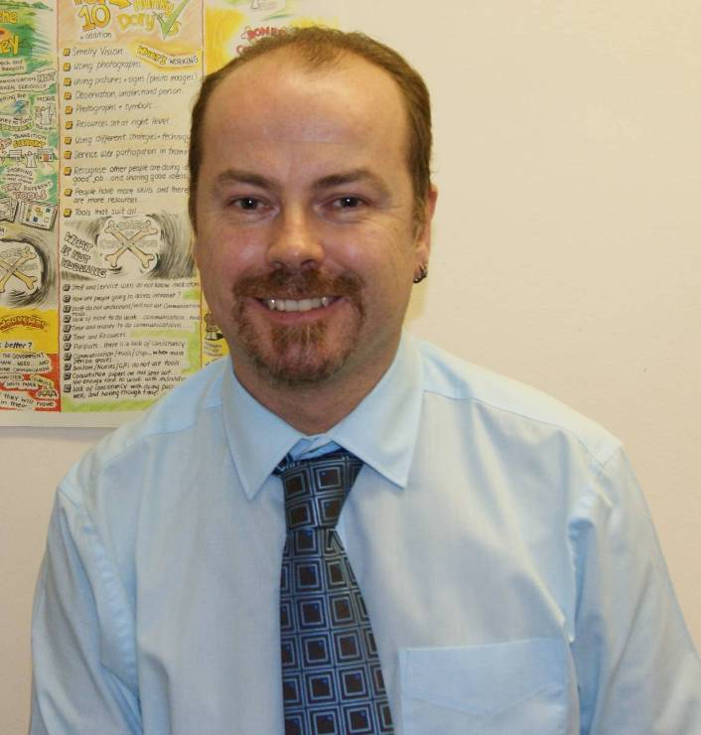

Jason Boyce
Communication Passport

Slide 2

Contents Page
How I communicate
My communication
Things I like to talk about
Not just words
Eating and drinking
Food and drink
My family
My friends
Special Moments & Events in My Life
My Past
Fun things
I can’t stand it
Physical information
Contact

Slide 3

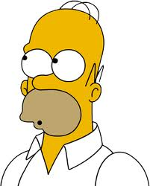
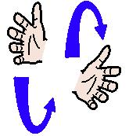
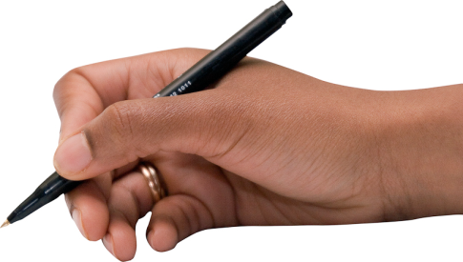
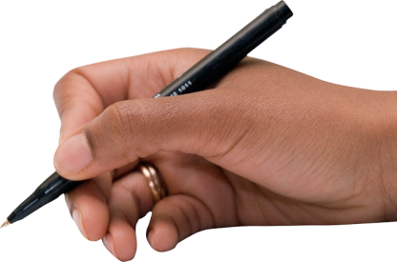

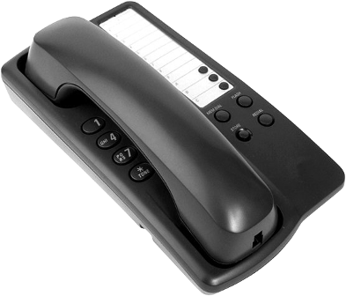
How I Communicate
Talk
Listen
Write
Write
Use some signs
Use E-mail
Use the Telephone

Slide 4



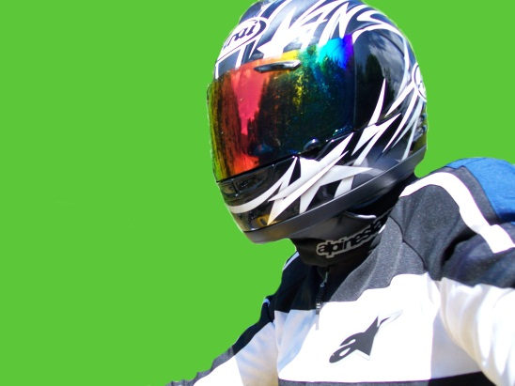

My Communication
You can help me to communicate:
Please Do:
Please Don’t:
Look at me while you are talking
Ask to sit down with me if I’m sitting down
Repeat things if I don’t hear first time
Sign slowly with me
Smile
Tap my shoulder to get my attention especially if I’m wearing my helmet
Talk while you are eating
Talk as you are walking away from me
Stand over me if I’m sitting down
Shout at me from another room
Interrupt me while I’m using the telephone unless essential

Slide 5
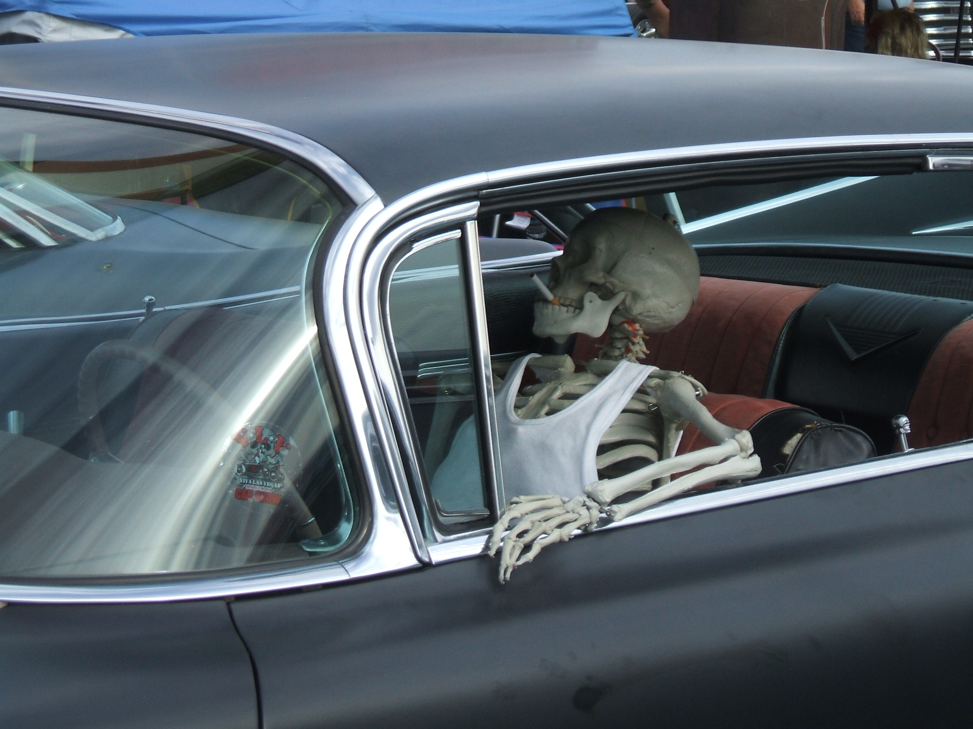
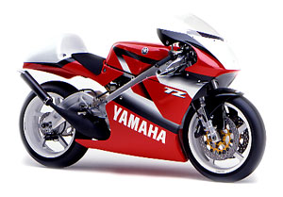



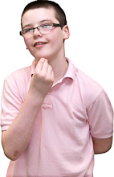
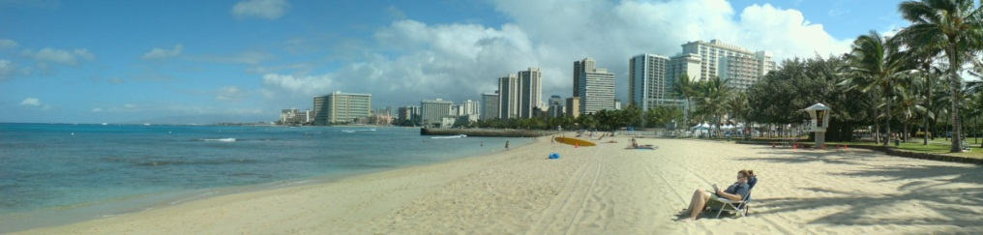
Things I like to
talk about
My family and friends
Motorbikes
My work
Music
My holidays and places I visit
New ideas

Slide 6
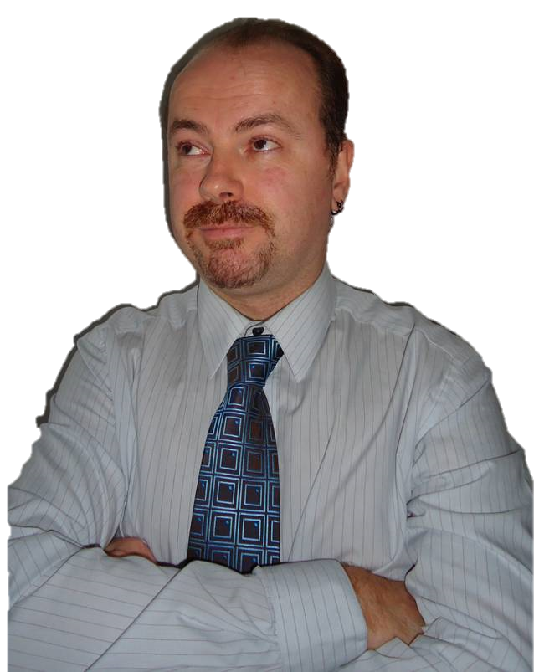
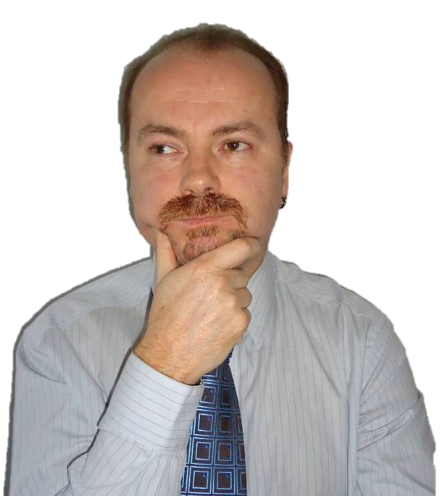

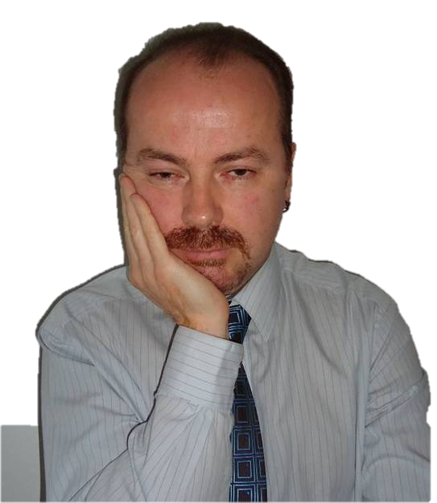
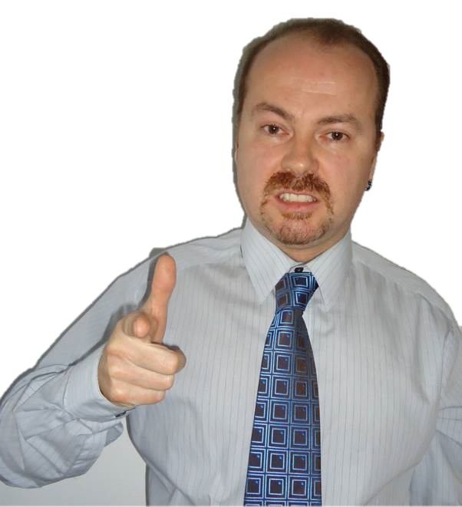
Not just words….
Blah blah blah
Check out my facial expressions and body language…..
……..does this help you understand what I’m saying?
“Do I think this is a good idea?”
I doubt it……
I need to think about this.
You need to give me a minute before I will reply
Definitely happy
Need coffee!!
Mr Angry, best keep away!

Slide 7
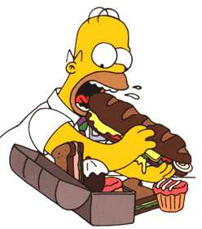
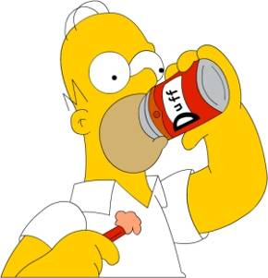

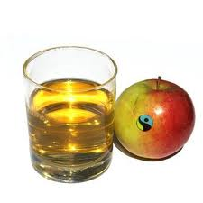
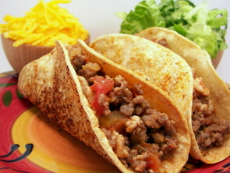
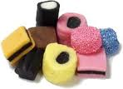

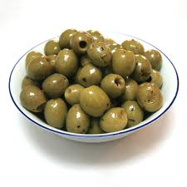
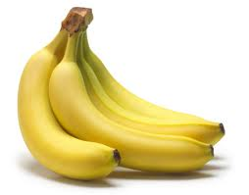
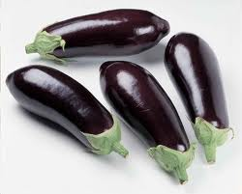
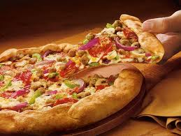

Eating and Drinking
Things I like: Things I don’t like:
Coffee
Apple juice
Chilli
Sweets
Guinness
Olives
Bananas
Aubergines
Pizza
Vimto

Slide 8


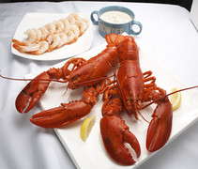
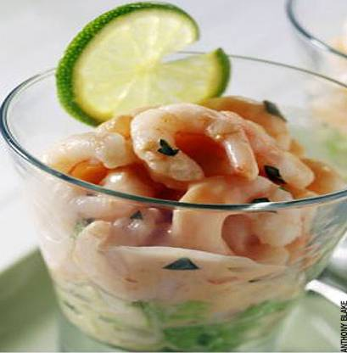
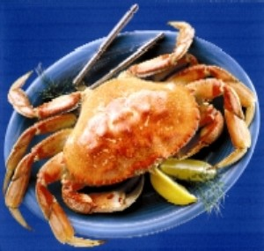


Food and Drink
I must NOT eat
Lobster
Prawns
Crab
I am Highly allergic to all shellfish.
Eating shellfish can kill me

Slide 9
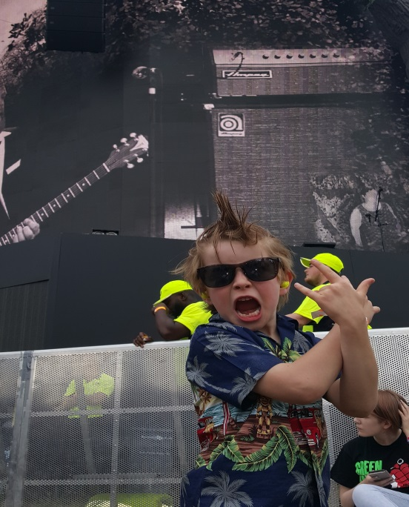
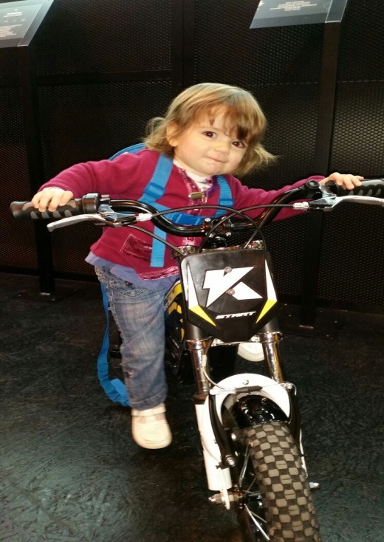
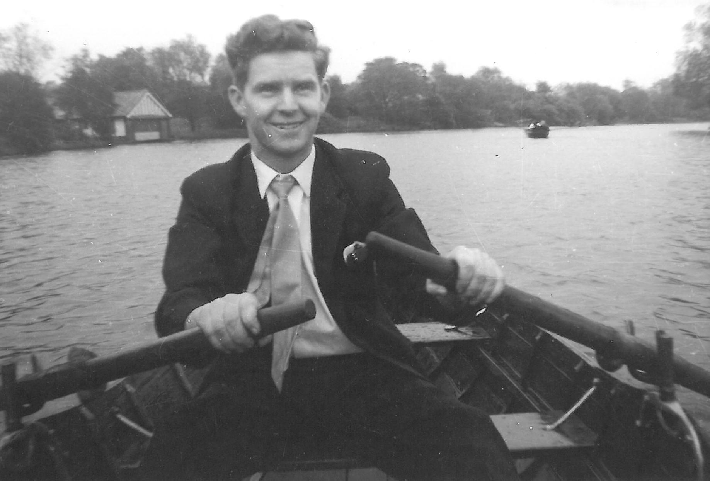
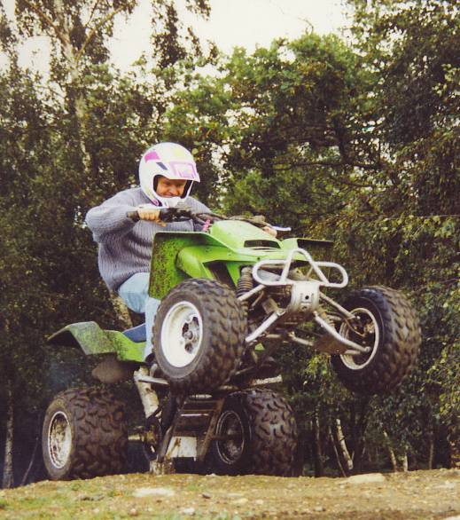
My Family
Edgar
This is my son. He loves punk rock!
My daughter likes to ride motorbikes.
Joseph
This is my Dad, Joe. He is 79 years old and still goes to work every day!!
He also does lots of crazy things, like riding quad bikes.

Slide 10
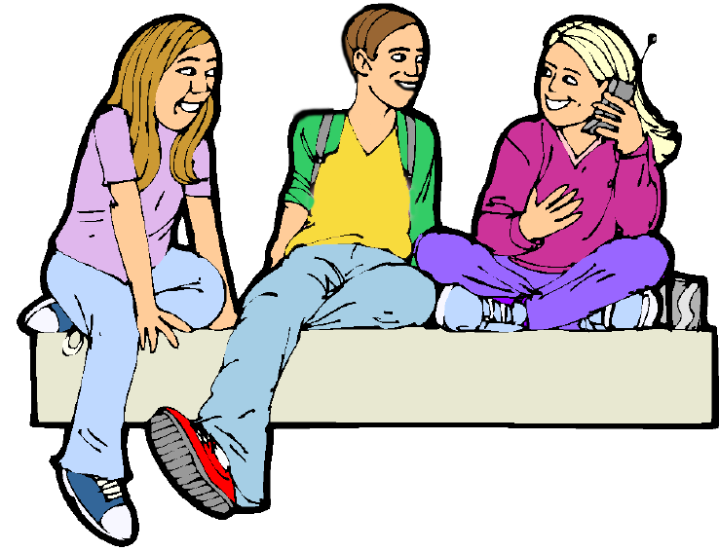
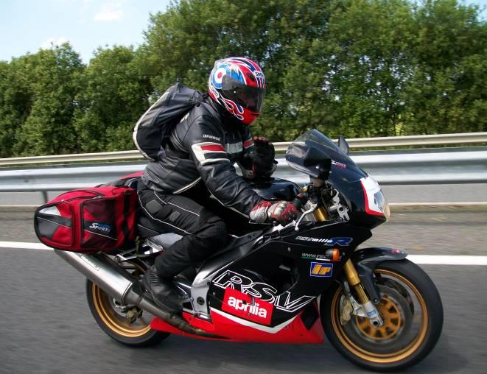
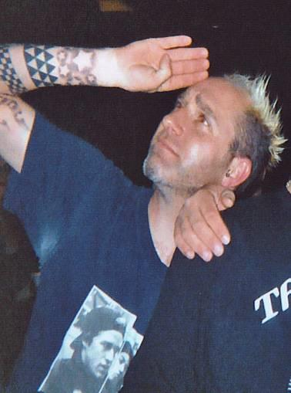
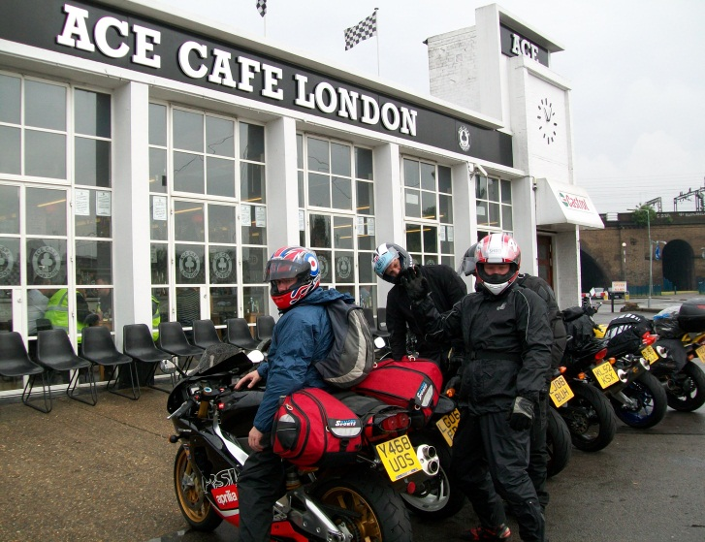
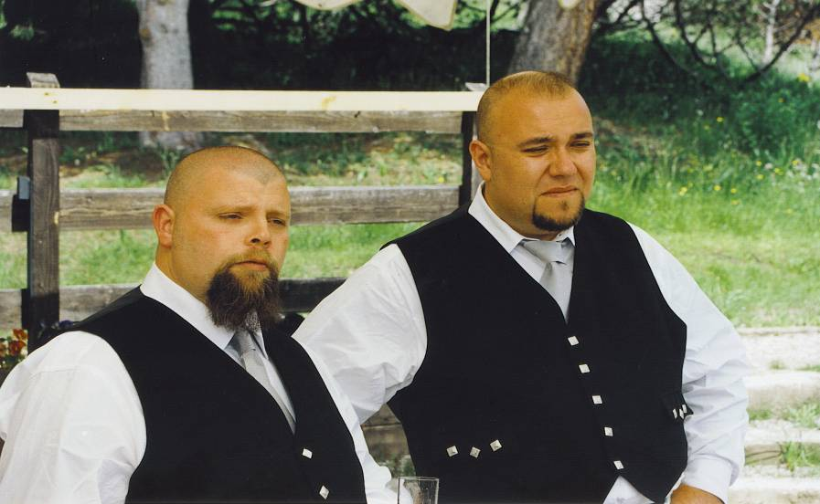
My Friends
Most of my friends ride motorbikes
Andy
Newton
The “Benny’s”
Brian

Slide 11

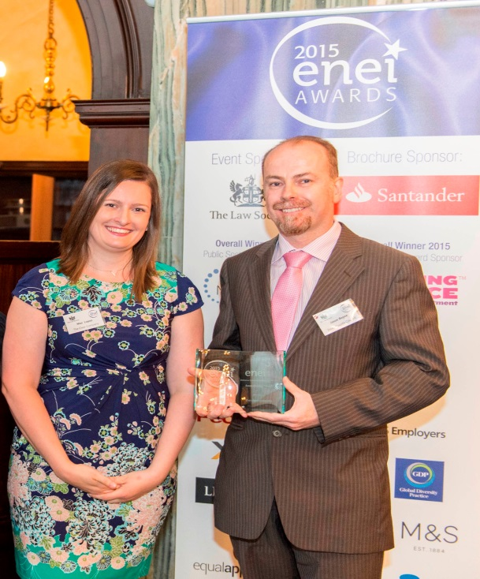
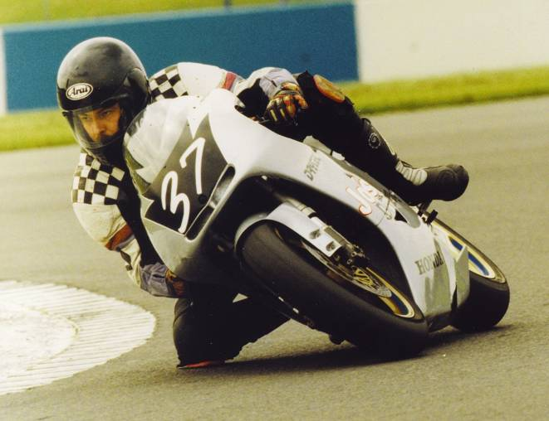
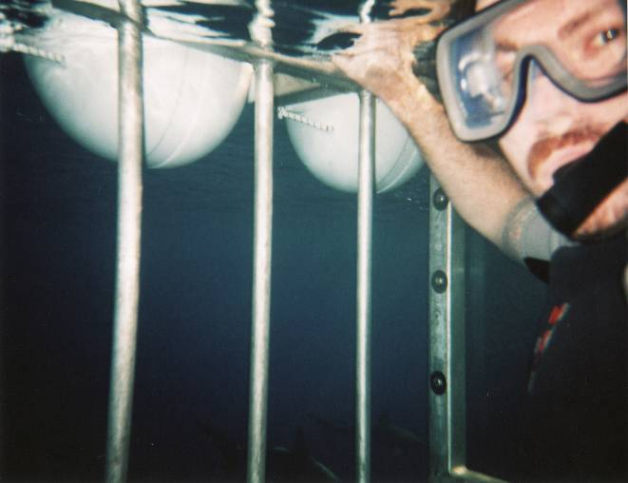
Special Moments and Events in My Life
Winning the
Law Society ENEI Award in 2015
Racing in MotoGP
Swimming with sharks

Slide 12
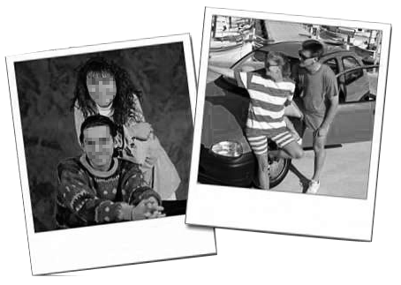
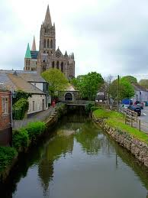
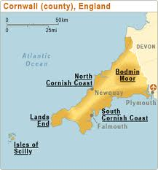
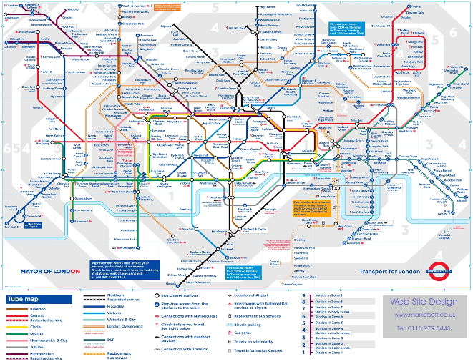

My Past
I was born in Truro, Cornwall
I have lived in London
I also have lived in New York

Slide 13
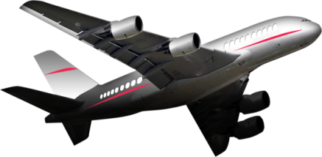
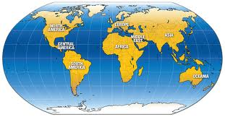
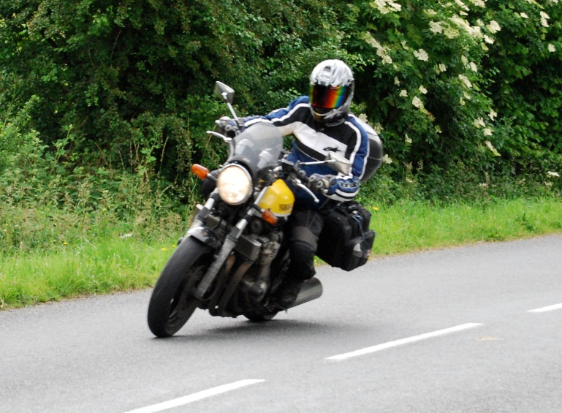
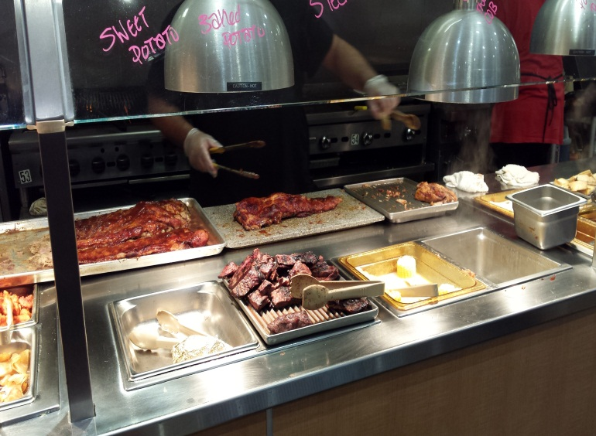
Fun things..!!
I like….
Going to new places & travelling.
I have been to;
Europe
North America
Africa
South America
Pacific Islands
Riding my motorbike
Trying new food

Slide 14

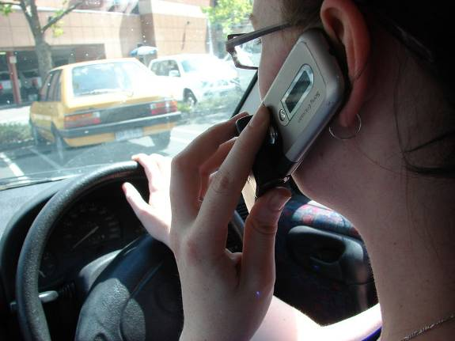
I can’t stand it!
People using their mobile phone whilst driving!!
So don’t say you haven’t been warned….

Slide 15
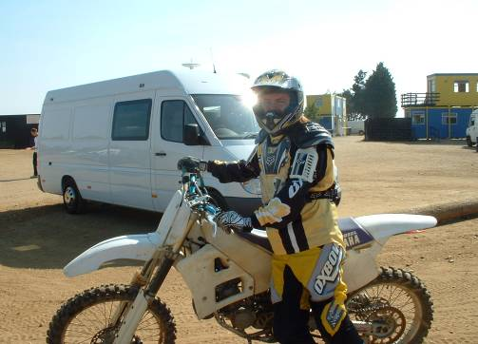
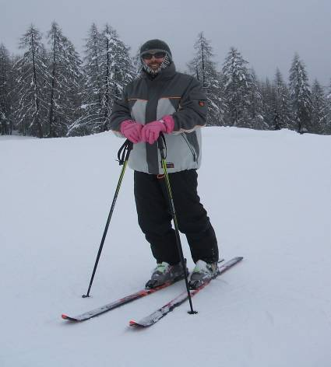



Physical Information
Motocross
I injured my knee in a motor bike crash.
Skiing
I need to wear my knee brace when I do these things:
Surfing
Quad biking

Slide 16

Contact
This Communication Passport belongs to:
Jason Boyce
My passport was created with help from:
My family and friends
Date: 1st September 2018
Based on a template and ideas from:
Anglia Community Enterprise (ACE)
Speech and Language Therapy Service
Address:
Jason.boyce@essex.gov.uk

