Slide 1
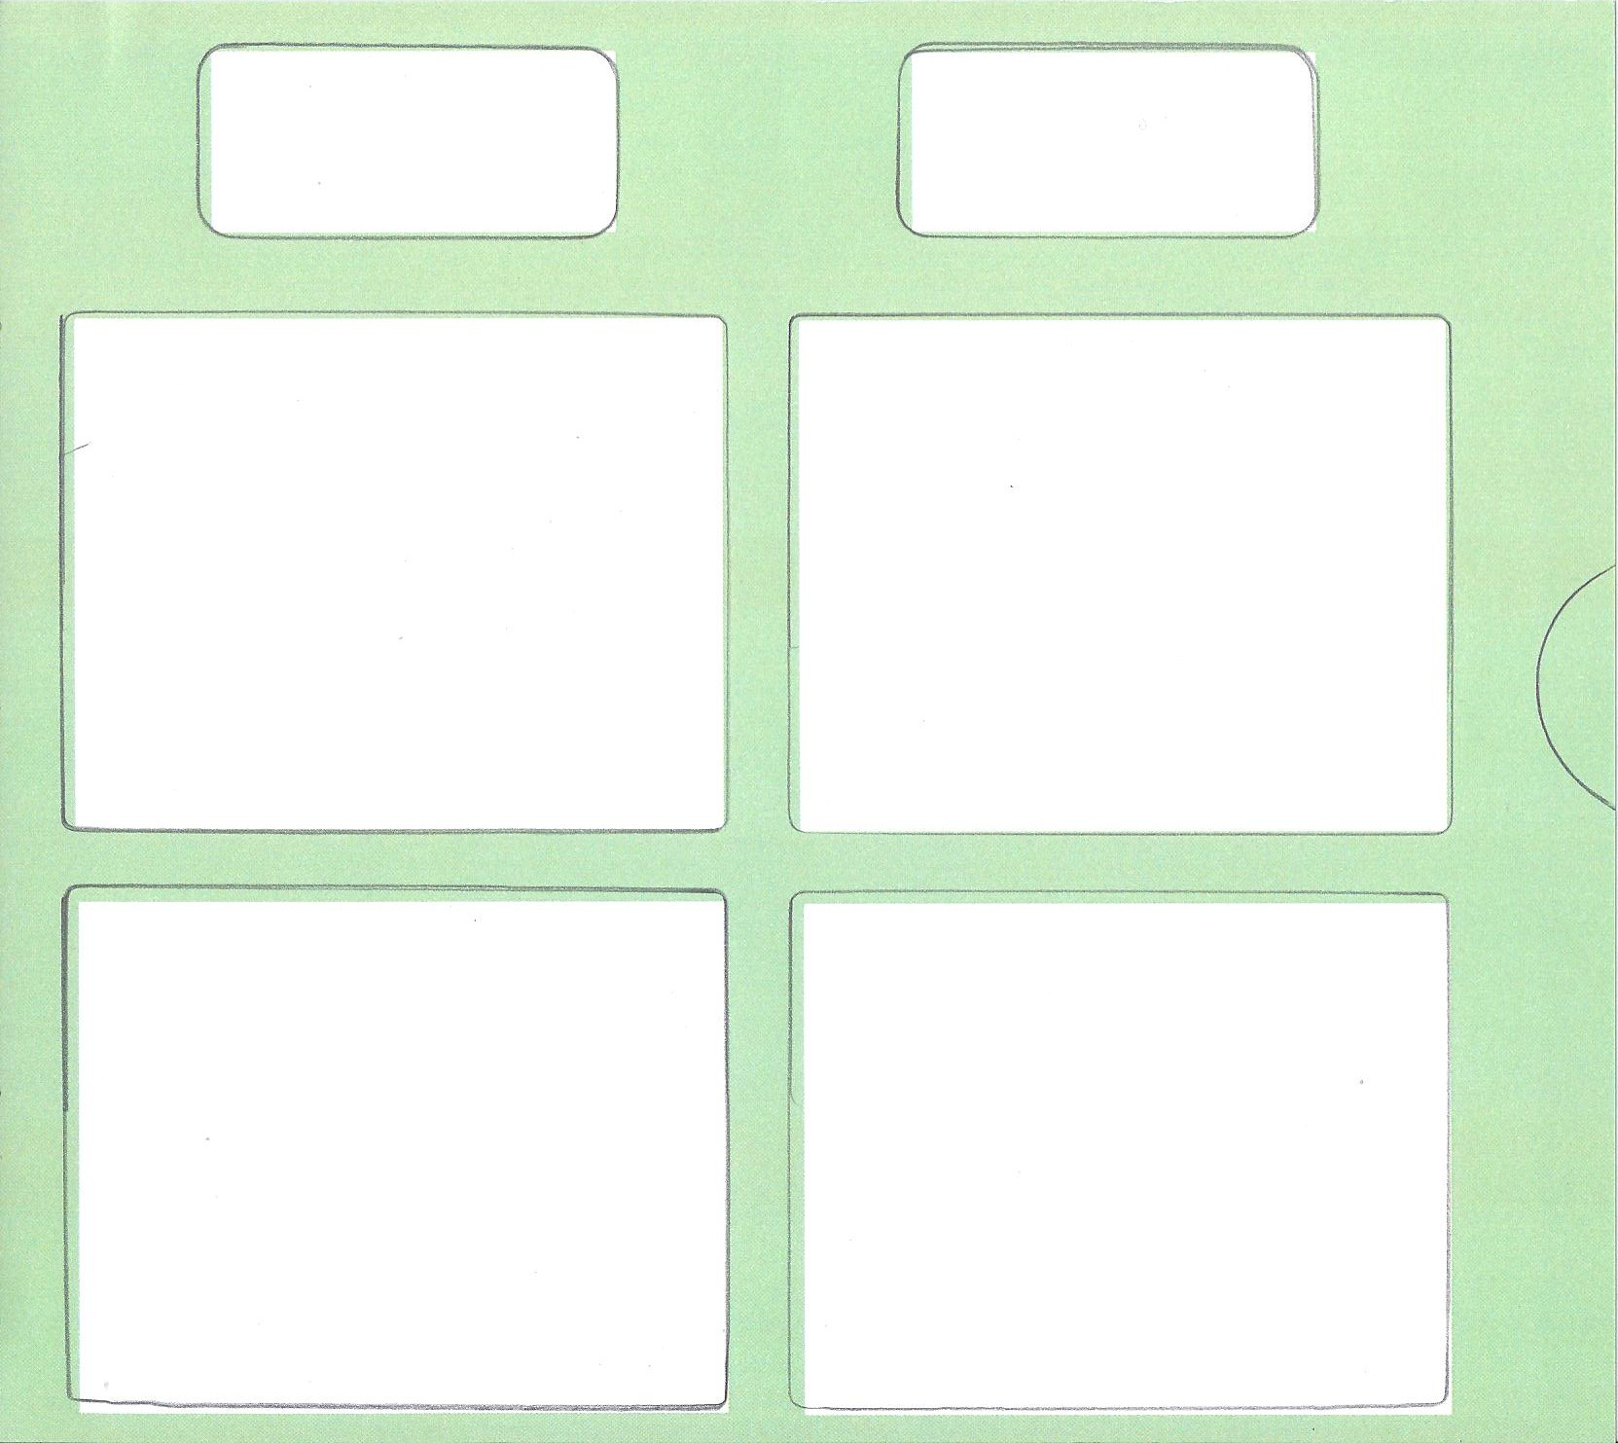

Slide 2
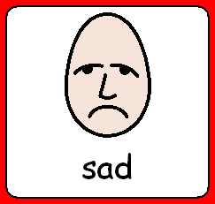

Slide 3
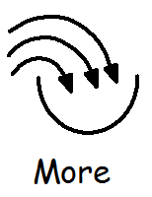

Slide 4
pencil
paper
paint
crayon

Slide 5
cut it
fold it
paint it
stick it

Slide 6
red
yellow
green
blue

Slide 9
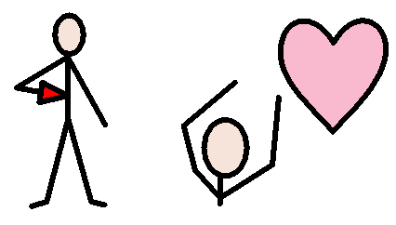
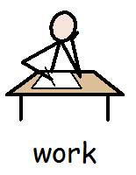
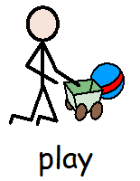
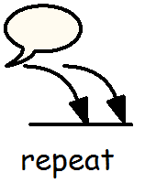
I want
I need help

Slide 10
Like
Don’t like

