Slide 2
Like
Not sure
Don’t like

Slide 3
Like
Not sure
Don’t like
Movies
Reading
Chatting
Singing
Drama
Music
Travel

Slide 4
Like
Not sure
Don’t like
Gardening
Cooking
Shopping
Games
Dancing
TV
Puzzles
Swimming

Slide 5
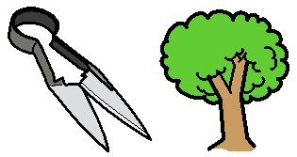
Like
Not sure
Don’t like
Digging potatoes
Weeding
Potting plants
Sowing
Trimming trees
Mowing the grass
Rake
Making pumpkins
Allotments

Slide 6
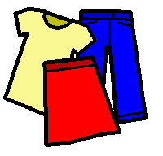
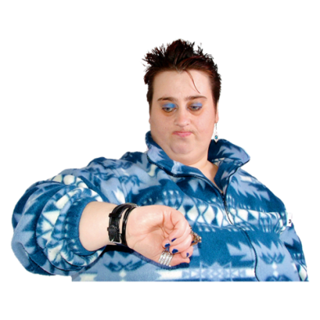
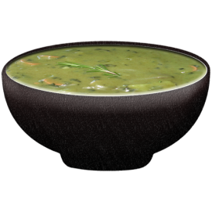
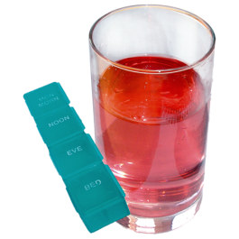
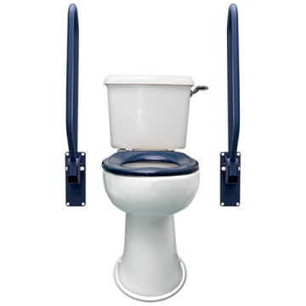
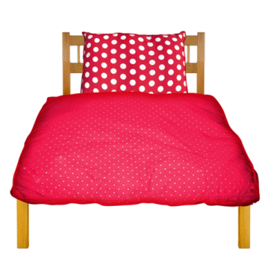
Nurse
Thank you
Help
Hello
Clothes
Water
Food
Medication
Bye
Bed

Slide 8
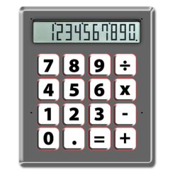
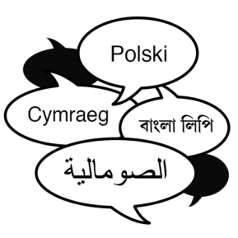
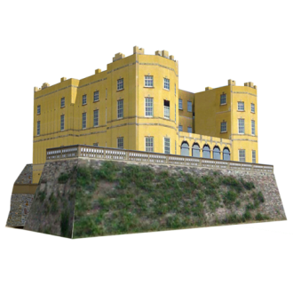
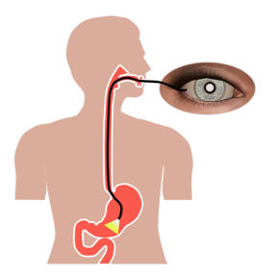
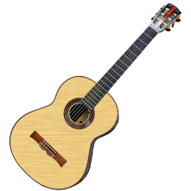
Like
Not sure
Don’t like
Maths
Art
Writing
Geography
R.E.
Languages
History
Science
Music

Slide 9
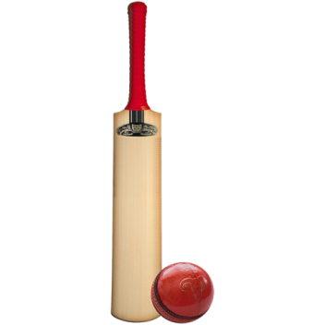
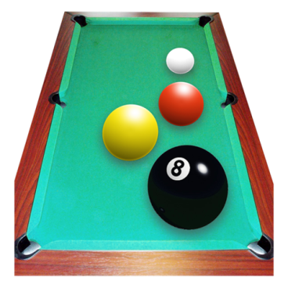
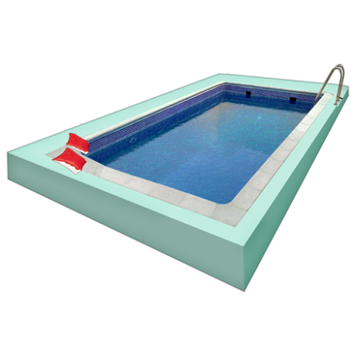
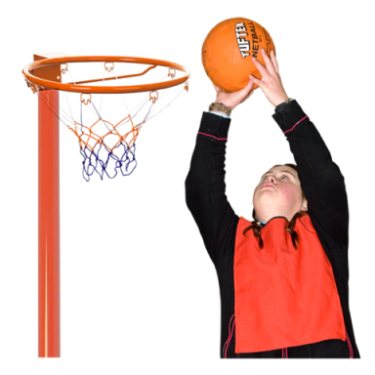
Like
Not sure
Don’t like

Slide 10
Like
Not sure
Don’t like
Funny
Scary
Sad
Hero
Characters
Bad guy
Very silly
Confusing
Interesting

Slide 11
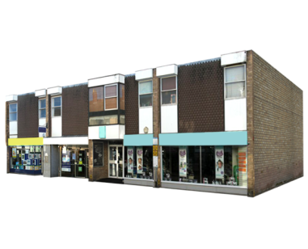
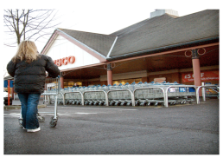
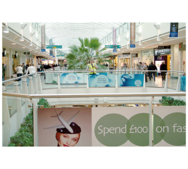
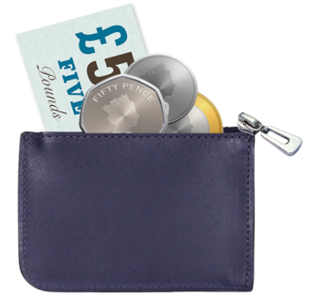
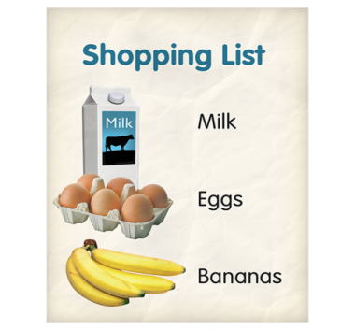
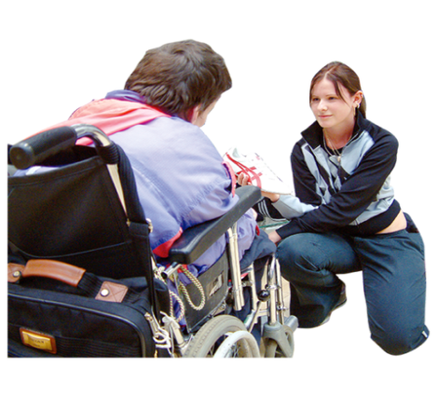
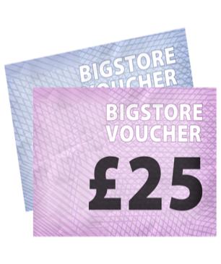
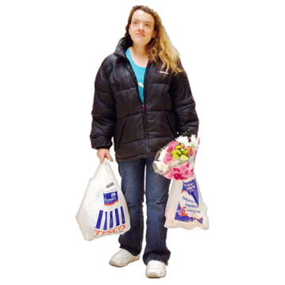
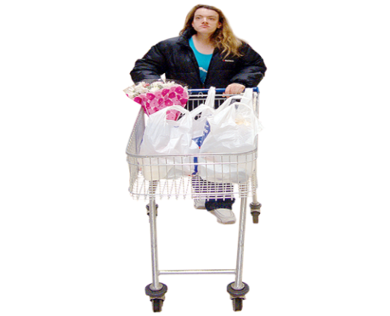
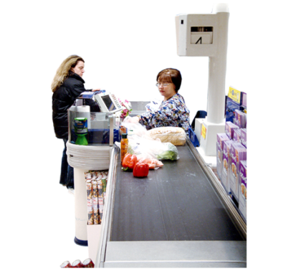
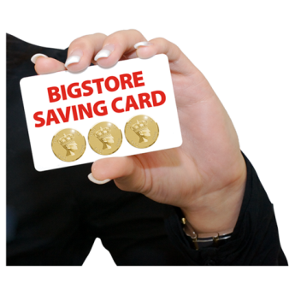
Can we go to the supermarket?
I want to go shopping.
Can we go to the shopping centre?
Can we go home now?
Where can I find these items?
How much does that cost?
Do you accept these vouchers?
Can I have Some bags please?
I need some help here.
Where are the disabled trolleys?
Can I have a receipt please?
Do you accept this store card?

Slide 12
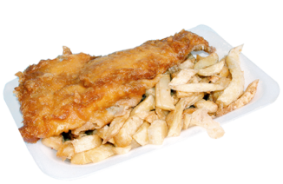
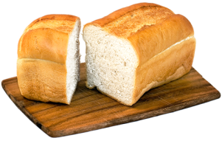
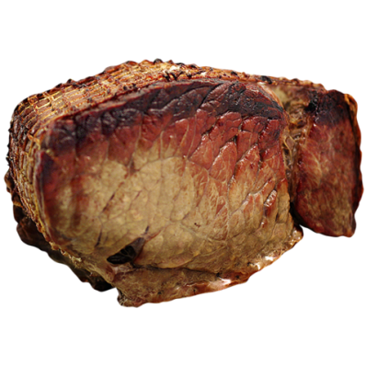
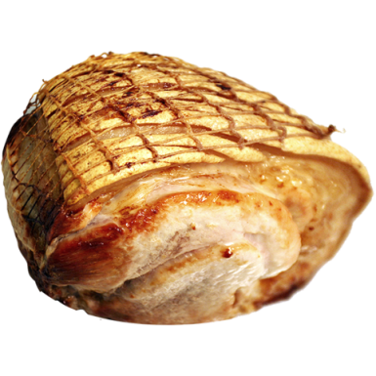
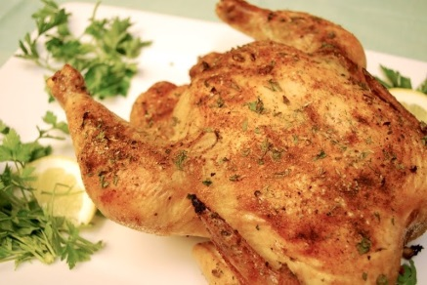
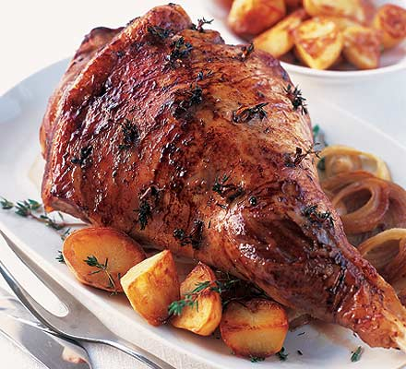
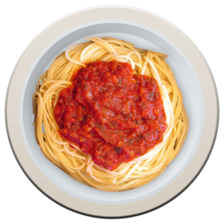
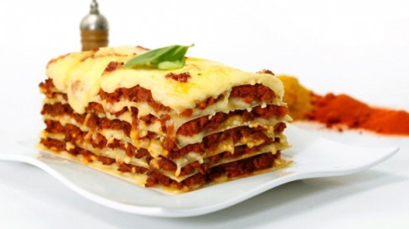
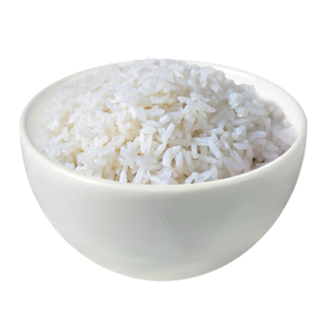
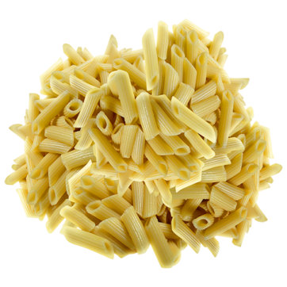
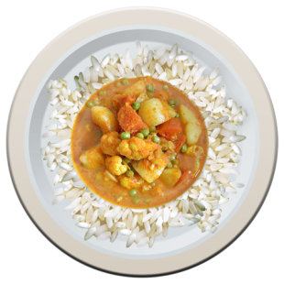
Soup
Fish and chips
Bread
Roast chicken
Roast beef
Roast pork
Roast lamb
Spaghetti Bolognaise
Lasagne
Pasta
Rice
Curry

