Slide 1
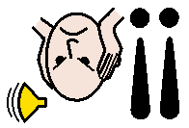
Trick or treat
Spooky
Sweets
Too scary
Too noisy
Quiet space

Slide 2
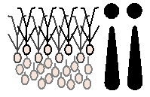
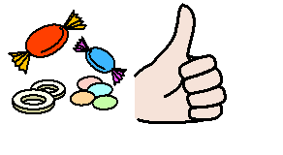
Halloween
Jack-o’-Lantern
Sour sweets
Too crowded
Too many
Just right

